Slide 1
Marketing

Slide 2

What comes to your mind when you think about the word Market?

Slide 3
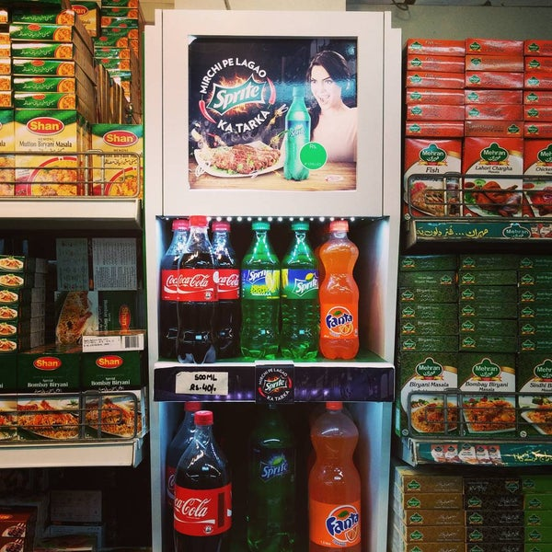
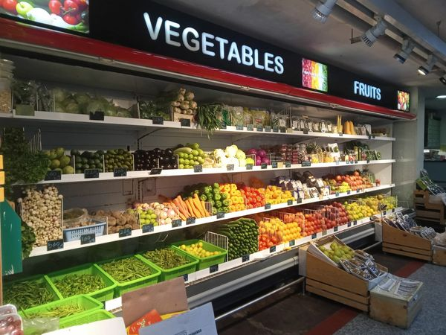
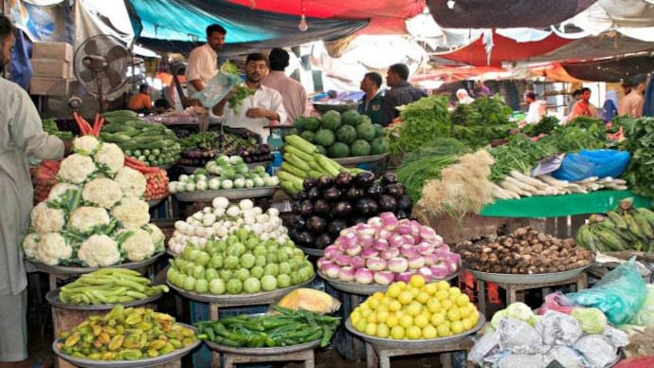

Slide 4
What’s the importance of studying this course?

Slide 5

-Understanding the true essence of ‘Value’ -Learning the art of marketing yourself -Changing Trends and constant innovation -Digitalization of the market -Overwhelming demand -Up skill your creative side
Importance of marketing

Slide 6
Road map of the course
STEP 04
STEP 03
Using case studies and taught concepts providing solution to the contingency scenarios.
Develop the core concept of consumer behviour,environment and branding strategies.
STEP 02
Stepwise learning of the different marketing strategies & concept of 4Ps, Needs, Wants and Demands
STEP 01
Learn and Understand the basics of Marketing and its concepts
Recommended book : Philip Kotler and Gary Armstrong, Principles of Marketing

Slide 7
Definition
“A market is a venue where buyers and sellers can meet to facilitate the exchange or transaction of goods and services. ”
Dr. Philip Kotler defines marketing as “the science and art of exploring, creating, and delivering value to satisfy the needs of a target market at a profit.
Marketing identifies unfulfilled needs and desires. It defines, measures and quantifies the size of the identified market and the profit potential.
It pinpoints which segments the company is capable of serving best and it designs and promotes the appropriate products and services.”

Slide 8
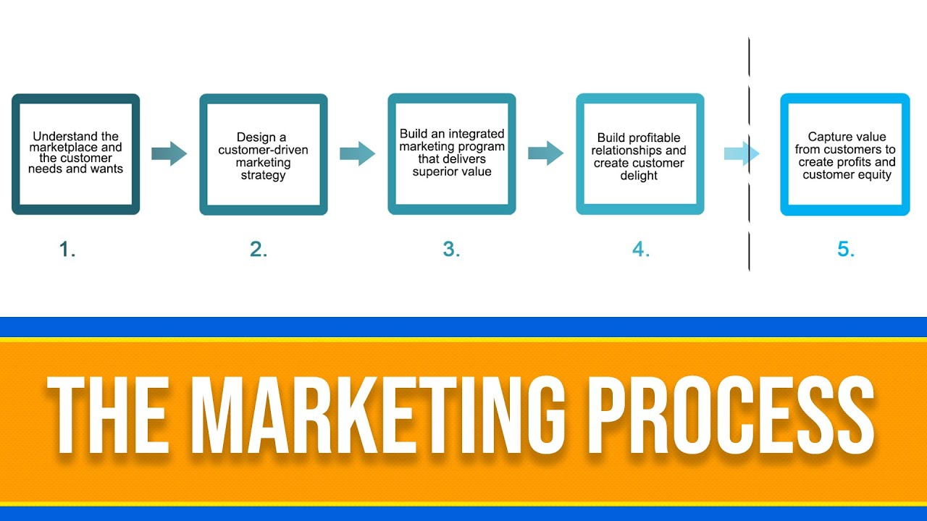

Slide 9
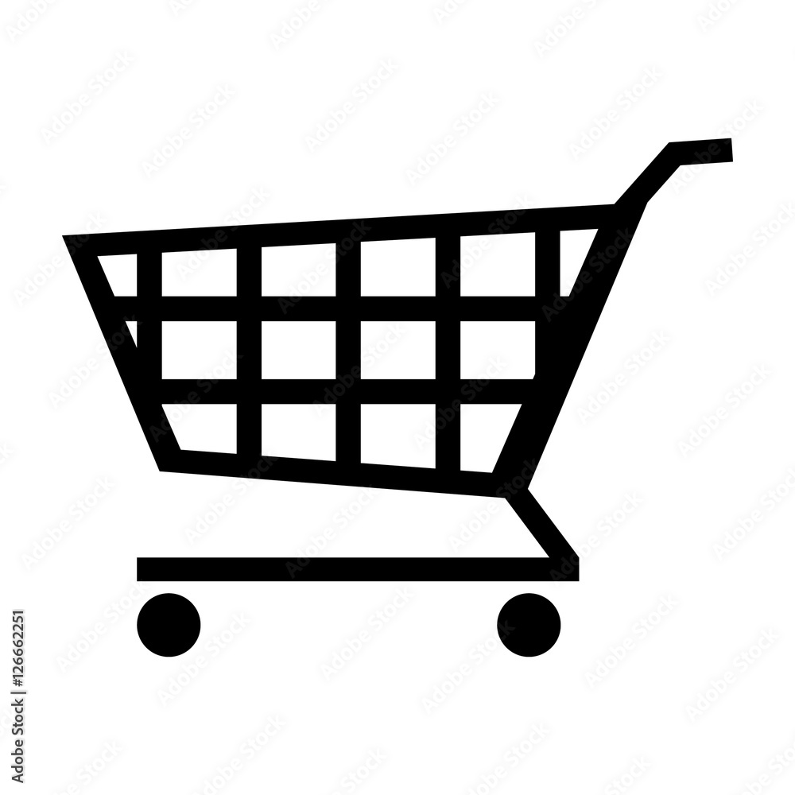
Marketplace
A marketplace is an area for people to come together to purchase and sell goods and services in the physical sense.
Online marketplace:
An online marketplace is a digital platform that connects two or more distinct groups of users in exchanges of products, services, or shared resources.

Slide 10
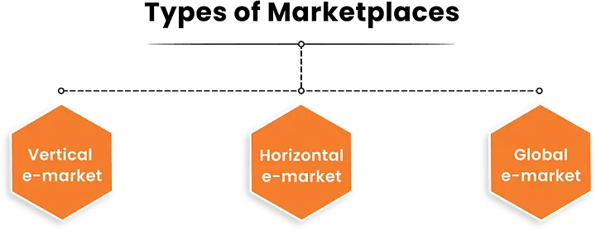

Slide 11

Vertical Marketplace
A vertical marketplace is an online store that sells only one type of product but its sources are different. Upwork, Indrive,Yango are good examples of a vertical store because they offer related services, but it doesn’t sell anything else like clothes or electrical stuff at its app.

Slide 12

Horizontal Marketplace
The horizontal marketplace is a store that offers different types of products but they all share the same category characteristics. A horizontal market is like a big supermarket that offers a wide variety of products that appeal to many different types of customers rather than just focusing on one specific group. Khaadi and Pakwheels are examples of horizontal marketplace.

Slide 13

Global Marketplace
The global marketplace is a type of store that sells almost everything of different categories and different types. AliExpress or Daraz is an example of global marketplace stores, where you can buy and sell different types of products. It ranges from the grocery, clothes, shoes, automobiles, electrical, electronic, etc.

Slide 14
NEEDS
Understanding the term

Slide 15

What are the Needs?
The fundamental requirements for human survival in today’s world are clothing, food, and shelter. Humans cannot survive without these. The products which fall under the needs category of products do not require a push. Instead the customer buys it themselves.

Slide 16
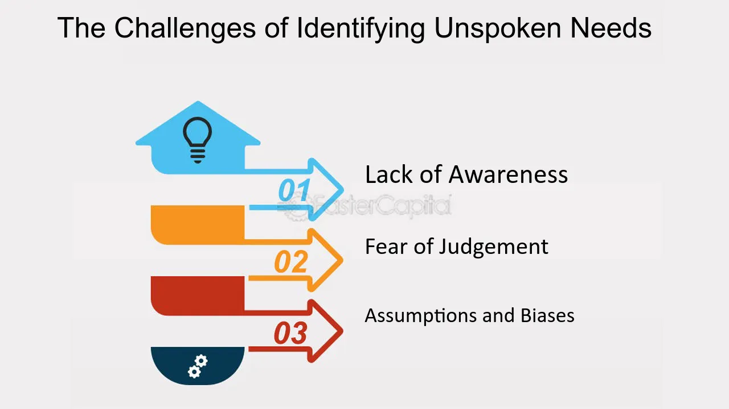

Slide 17
Types of needs in marketing
Stated Needs: The customer expresses these needs clearly. Someone might say, “I am looking for a mobile phone,”.
Real needs: In this case, the accuracy of the customer’s request is important. If someone is looking for a mobile phone for advanced vloging or video editing, they need something with a lot of computing power instead of just an ordinary screen.
Unstated needs: Unstated needs are the needs that customers may not be aware of, but which can be inferred through observation and analysis. For example, they may hope for a long warranty when buying the phone.
Delight needs: In this group, buyers wish for an extra benefit that adds value, although they might not say so. For example an expectation of getting premium phone cover or a complimentary Air pod with phone.
Secret Needs: These are wants that people may be unwilling to express. For example, they might buy a fancy phone to project a particular image, but they might not publicly discuss these reasons.

